Slide 1

Automated Web Reconnaissance Tool Review I
Internal Guide Presented By
Date of Presentation :

Slide 2
Introduction
We are creating a Bash script tool that gathers information from websites using a variety of tools like gobuster, nmap, nmap Automator, ping, curl, and dirb. The tool is user-friendly and managed through a GitHub repository. My goal is to create an effective tool that can be used in cybersecurity, web development, and network management.
Make information gathering on the internet easier and more efficient for professionals in cybersecurity, web development, and network management.

Slide 3
Relevance and Need of the Project in the Present Context
In today's digital age, websites are crucial for businesses and individuals.
However, gathering information from websites can be a tedious and time-consuming task.
Our automated reconnaissance tool solves this problem by providing a user-friendly solution that quickly and efficiently gathers information using multiple tools.
Professionals in cybersecurity, web development, and network management can benefit from this tool by improving their efficiency in information gathering.
By creating this tool, we are contributing to the growing need for streamlined information gathering and providing a valuable resource for those who need to gather information from websites.

Slide 4
Literature Survey – 5 systems
Name of the System | Technologies or Algorithms used | Features | Drawbacks
"Information Gathering Techniques and Tools for Network Penetration Testing” | Nmap Nessus | Port scanning, service identification, OS identification, and vulnerability scanning Support for various protocols such as TCP, UDP, ICMP, and ARP | Limited reporting capabilities Requires manual configuration for advanced options
“Web Application Vulnerability Scanners” | Acunetix Burp Suite | Detection of common web application vulnerabilities such as SQL injection and cross-site scripting (XSS) Support for various programming languages such as PHP, Java, and .NET | False positives and false negatives Limited support for custom web applications
“Automated Information Gathering and Reconnaissance Techniques for Network Security” | Nmap Netdiscover | Discovery of network topology and active hosts Detection of open ports and services running on those ports Enumeration of operating system information and application versions | Limited support for encrypted traffic Vulnerable to network-based countermeasures such as intrusion detection/prevention systems (IDS/IPS)

Slide 5
Literature Survey – 5 systems
Name of the System | Technologies or Algorithms used | Features | Drawbacks
"A Survey of Open Source Intelligence Gathering Tools” | Maltego Recon-ng theHarvester | Provides an overview of OSINT tools and techniques, including web scraping, data mining, and social media analysis. | Limited coverage of manual techniques and may not cover all OSINT tools and techniques.
“An Overview of Information Gathering Techniques and Tools for Security Testing” | Nmap Nessus Metasploit | Scanning of network devices for vulnerabilities and open ports Enumeration of network and system information such as operating system and application versions Detection of weak passwords and default configurations | Limited support for advanced vulnerability testing such as zero-day exploits Requires a high level of technical expertise to operate effectively

Slide 6
Problem Statement and Objectives
Problem Statement:
Variability in website structure and design, which can make it challenging to navigate and extract information.
Inconsistencies in the quality and reliability of information found on different websites.
Issues with web scraping, including legal and ethical considerations and technical challenges such as anti-scraping measures.
Difficulty in processing and analysing large volumes of information collected from multiple websites.

Slide 7
Problem Statement and Objectives
Objectives:
Develop a bash script-based tool that uses existing tools such as Nmap, Dirb, Gobuster, and Curl to gather information from websites.
Save time for penetration testers by automating the process of gathering information from websites.
Enhance the efficiency and effectiveness of penetration testing by providing a comprehensive and easy-to-use tool for information gathering.

Slide 8
Proposed Approach
Identify the requirements: Before starting the development, it is essential to identify the requirements of the tool. This can be done by understanding the needs of the penetration testers and analyzing the features of the existing tools such as nmap, dirb, gobuster, and curl.
Design the tool architecture: After identifying the requirements, the next step is to design the architecture of the tool. This can be done by defining the modules, functions, and their relationships. The tool should be designed in such a way that it is flexible, scalable, and easy to use.
Develop the tool: Once the architecture is designed, the development of the tool can be started. The tool can be developed using the bash scripting language, which is widely used for automating tasks. The existing tools such as nmap, dirb, gobuster, and curl can be integrated into the tool to gather information from the websites.
Test the tool: After the development of the tool, it is essential to test it thoroughly. The testing can be done by simulating real-world scenarios and checking the tool's performance, accuracy, and reliability.
Deploy the tool: After the testing is completed, the tool can be deployed for use by penetration testers. It is important to provide proper documentation and support to ensure that the tool is used effectively.

Slide 9
Unique Features of the Proposed System
Integration of multiple existing tools: The proposed system would combine the functionality of multiple existing tools, such as nmap, dirb, gobuster, and curl, into a single cohesive tool. This could save time and effort for penetration testers who would otherwise need to use each tool separately.
Customization and flexibility: Since the system is based on a bash script, it would likely be highly customizable and flexible, allowing users to modify and tweak it to suit their specific needs.
Automated information gathering: The system would automate the process of gathering information from websites, potentially allowing for faster and more comprehensive reconnaissance.

Slide 10
Utility value of the Proposed System
Saves time for penetration testers by automating information gathering from websites.
Increases efficiency by using existing tools such as Nmap, dirb, gobuster, and curl.
Provides a user-friendly interface for ease of use and quick access to gathered information.
Enables quick identification of potential vulnerabilities and threats, allowing for timely remediation.
Enhances overall security posture by providing a comprehensive view of website assets and potential risks.
Improves accuracy and completeness of information gathering by utilizing multiple tools and techniques.

Slide 11
Users of the System
Penetration testers
Cybersecurity professionals
Security researchers
Information security consultants
IT administrators
System/network administrators
Ethical hackers
Students/researchers in cybersecurity and related fields.

Slide 12
Functional Requirements
S. No. | Description | Stimulus | Response | Dependencies and Constraints (if any)
1 | The system should have a user interface that allows the user to input a website URL to begin the information gathering process. | User input. | The system accepts the input and begins the information gathering process for the specified URL. | The URL should be valid and accessible.
2 | The system shall perform port scanning using Nmap to identify open ports on the target system. | Information gathering process initiated. | The system uses Nmap to scan the target system and identifies open ports. | Nmap must be installed on the system.
3 | The system should use Dirb and Gobuster to perform directory enumeration on the target system to discover hidden files and directories. | Information gathering process initiated. | The system uses Dirb and Gobuster to scan the target system and identifies hidden files and directories. | Dirb and Gobuster must be installed on the system.
4 | The system should use cURL to perform HTTP requests on the target system to obtain web pages and their contents. | Information gathering process initiated. | The system uses cURL to obtain web pages and their contents on the target system. | cURL must be installed on the system.
5 | The system should save the gathered information into a report file for future reference. | Information gathering process completed. | The system saves the gathered information into a report file. | The report file should be in a readable format.

Slide 13
Non-Functional Requirements
Performance: The tool should be able to gather information from websites within a reasonable amount of time, and should not significantly impact the performance of the system on which it is running.
Usability: The tool should be easy to use and understand, even for users with limited technical knowledge or experience.
Compatibility: The tool should be compatible with a wide range of operating systems and environments, and should not require any additional software or hardware beyond what is commonly available.
Security: The tool should be designed and implemented with security in mind, and should not introduce any new vulnerabilities or risks to the system on which it is running or the websites being scanned.
Reliability: The tool should be reliable and stable, and should not crash or produce inaccurate results under normal operating conditions.
Scalability: The tool should be able to handle a large number of requests and websites, and should not significantly degrade in performance as the number of requests increases.

Slide 14
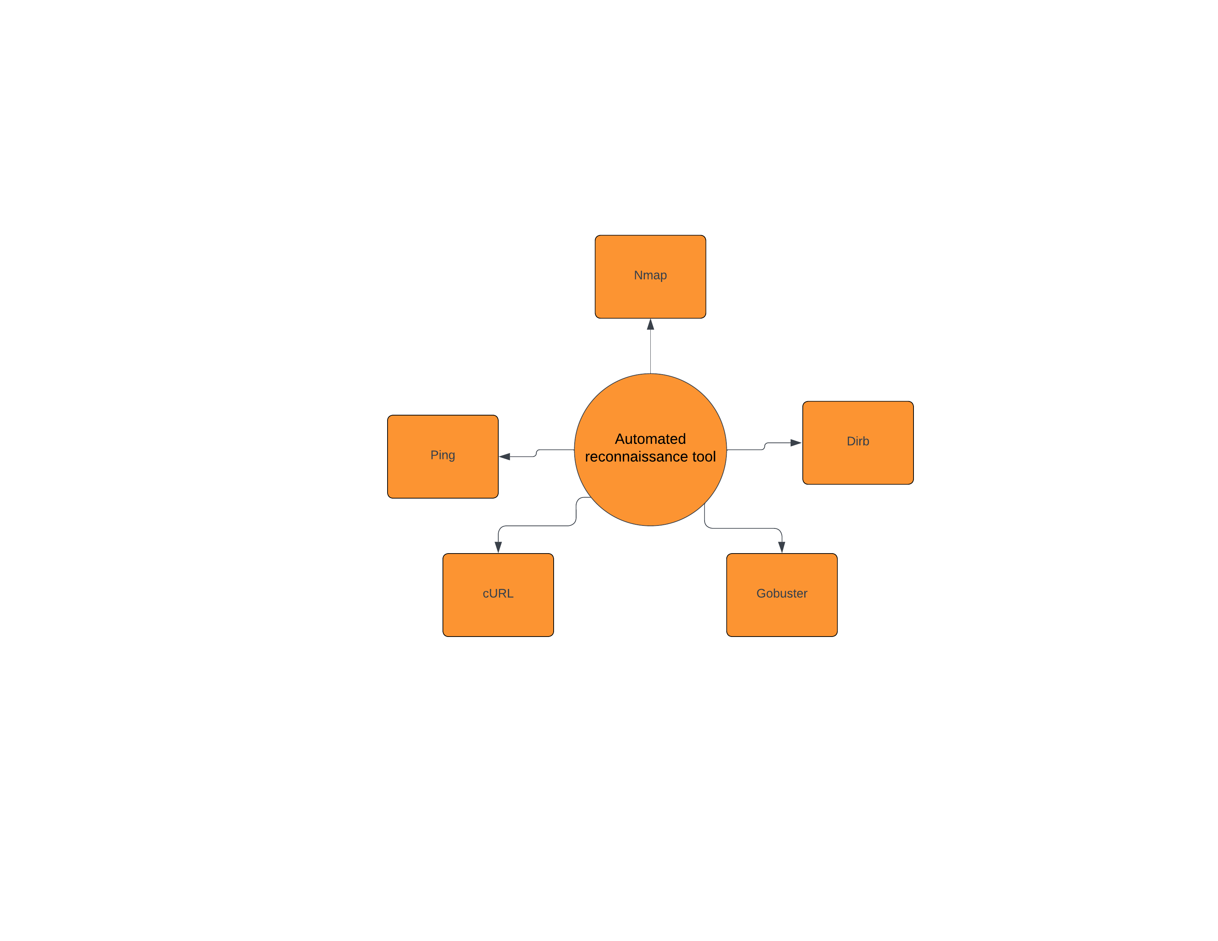
Context Diagram

Slide 15
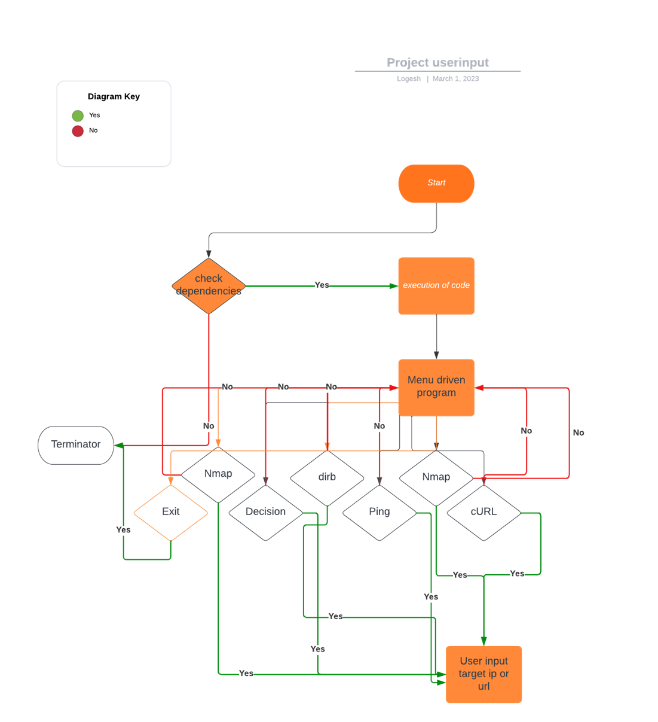
Data Flow Diagram

Slide 16
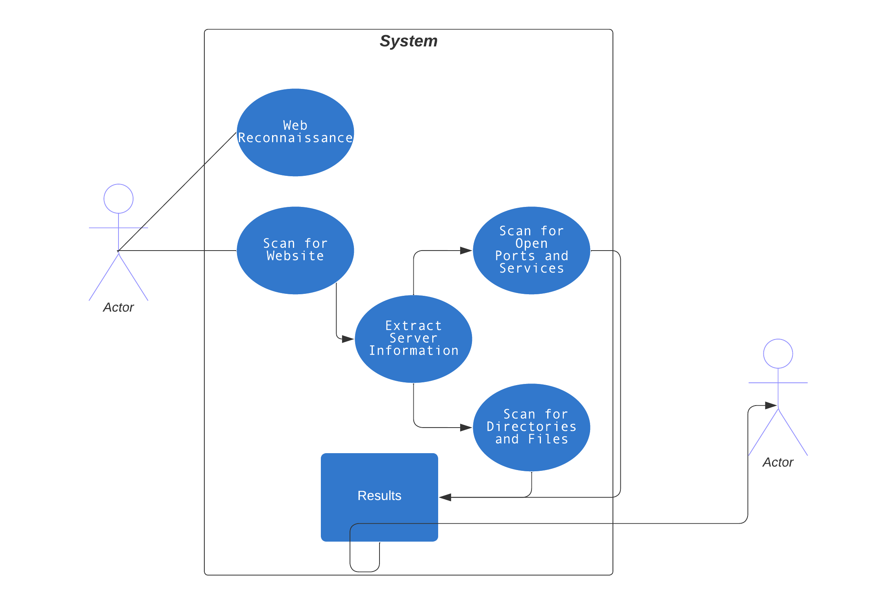
Use Case Diagram

Slide 17
Screen Interface Designs
Main Menu: A simple menu interface that allows the user to select the desired option from a list of choices.
Target Input: A screen that prompts the user to input the target URL or IP address of the website they want to scan.
Status Check: A screen that displays the status of the target website, whether it's up or down.
Server Info: A screen that displays the server information of the target website, such as the web server type and version.
Nmap Scan: A screen that displays the results of the Nmap scan, including the open ports and services running on the target machine.
Dirb Scan: A screen that displays the results of the Dirb scan, including the directories and files found on the target website.
Gobuster Scan: A screen that displays the results of the Gobuster scan, including the directories and files found on the target website.
Results: A screen that displays all the results of the scans in a single place for the user to review.
Error Handling: A screen that displays any error messages or alerts that the script may encounter during the scanning process.

